Slide 1
Presented By:
YASH JAISWAL

Slide 2
HOUSING PROJECT
1) High Return
2) Condition of Sale
3) Type of Sale

Slide 3
Problem Statement:
You are required to model the price of houses with the available independent variables. This model will then be used by the management to understand how exactly the prices vary with the variables. They can accordingly manipulate the strategy of the firm and concentrate on areas that will yield high returns. Further, the model will be a good way for the management to understand the pricing dynamics of a new market.

Slide 4
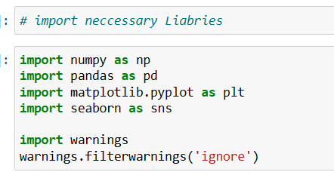
Libraries

Slide 5
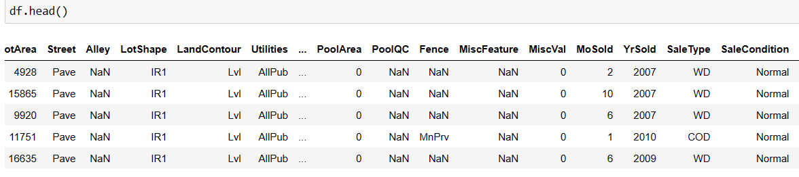
DATASET :

Slide 6
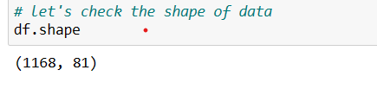
DATASET SHAPE :

Slide 7
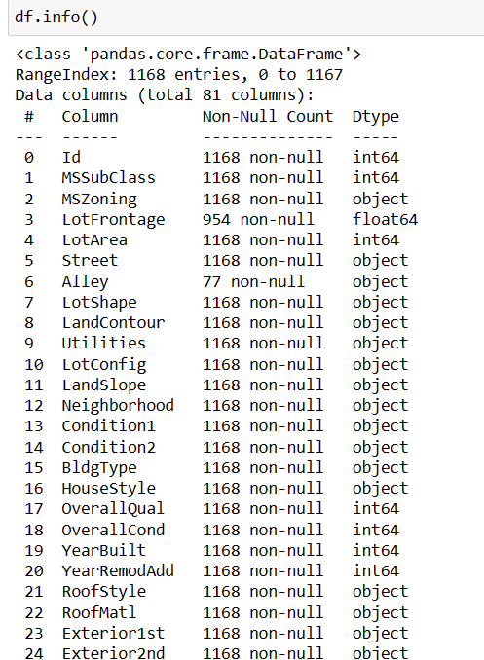
DATASET INFORMATION :

Slide 8
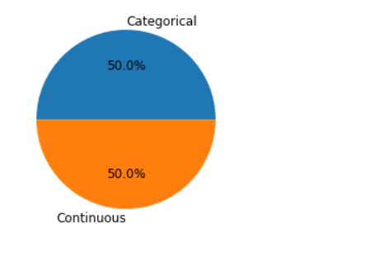
Exploratory Data Analysis: Univarient

Slide 9
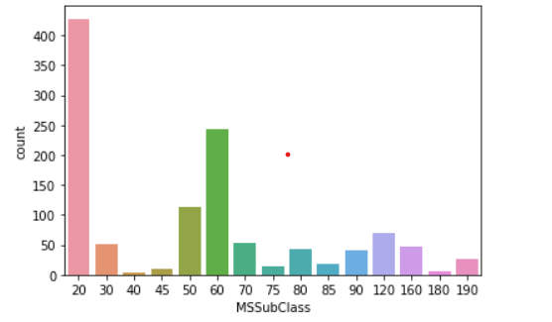
VISUALIZATIONS (EDA)

Slide 10
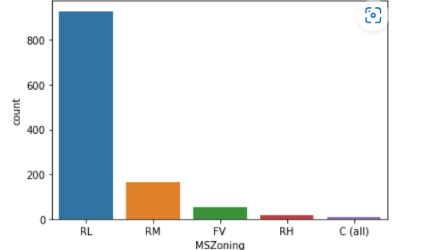
MSZoning -> majority are RL

Slide 11
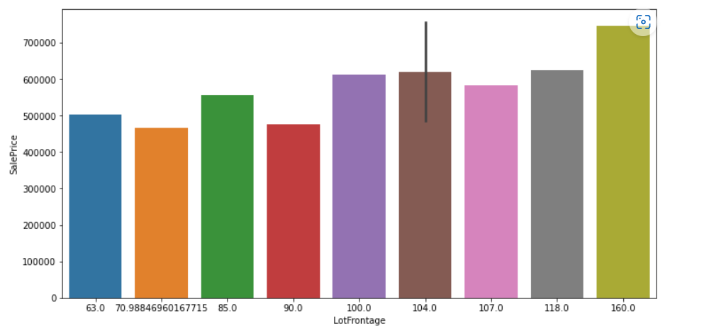
LOTFRONTAGE -> Majority are 160

Slide 12
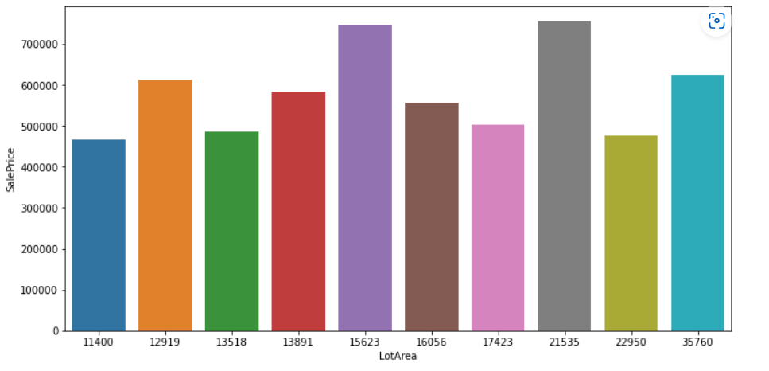
LOTAREA -> Majority are 15623 and 21535

Slide 13
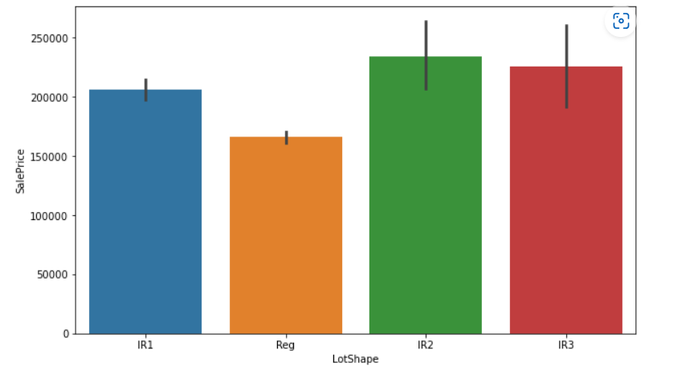
LOTSHAPE -> Majority are IR2

Slide 14
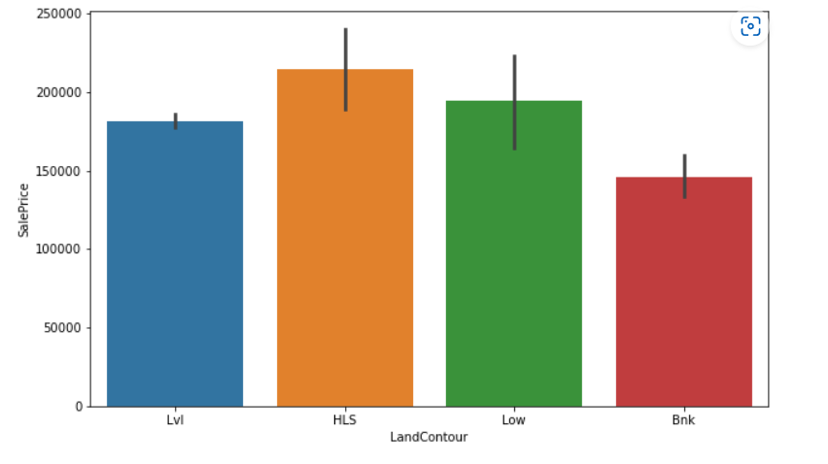
LANDCONTOUR -> Majority are HLS

Slide 15
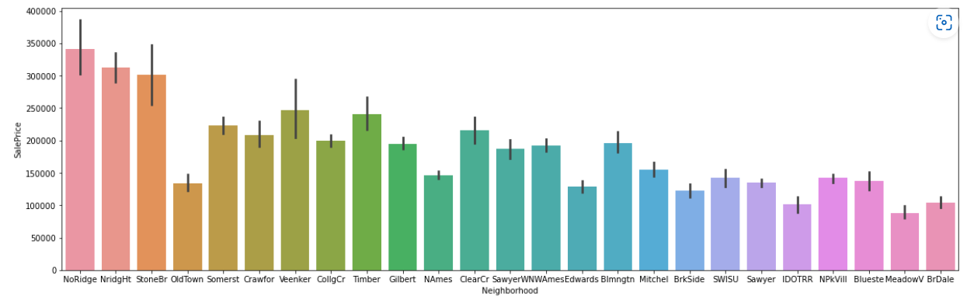
NEIGHBORHOOD -> Majority are NoRidge

Slide 16
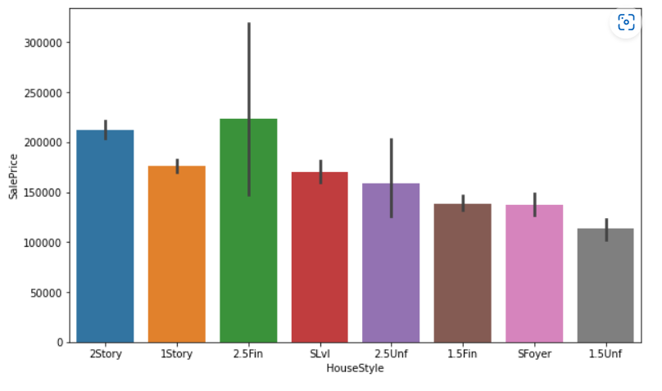
HOUSESTYLE - > Majority are 2.5 Fin

Slide 17
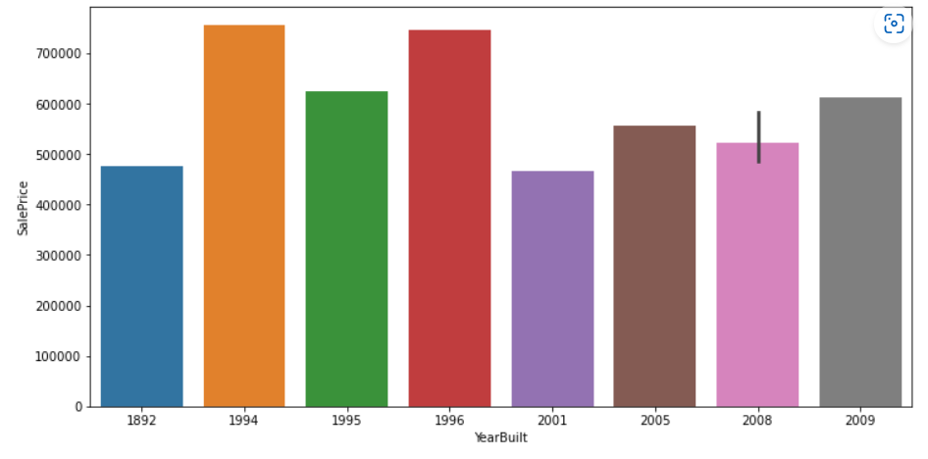
YEARBUILT - > Majority are 1994

Slide 18
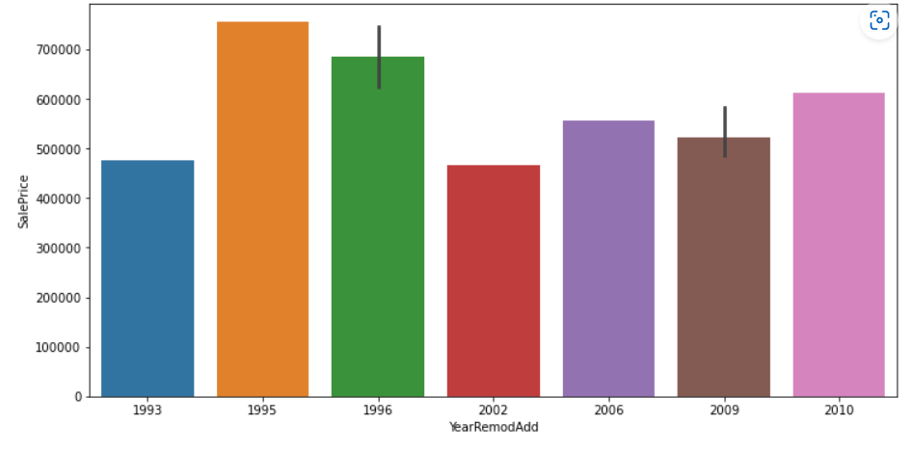
YEARREMODADD -> Majority are 1995

Slide 19
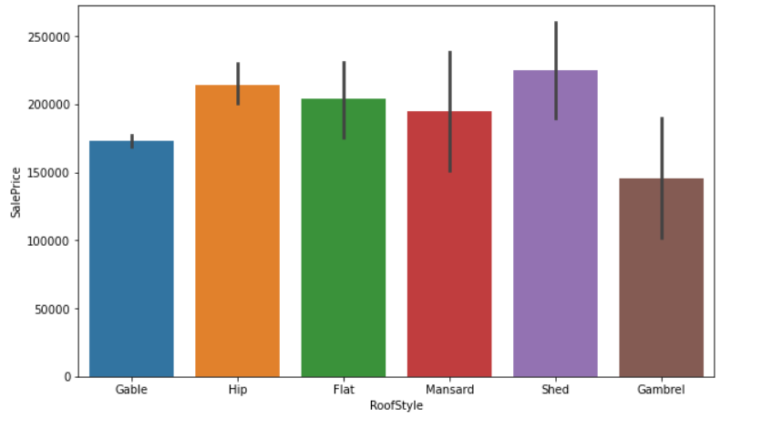
ROOFSTYLE -> Majority are Shed

Slide 20
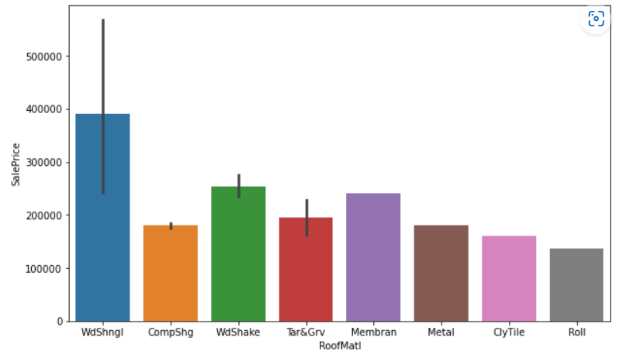
ROOFMATI -> Majority are WDSHNGI

Slide 21
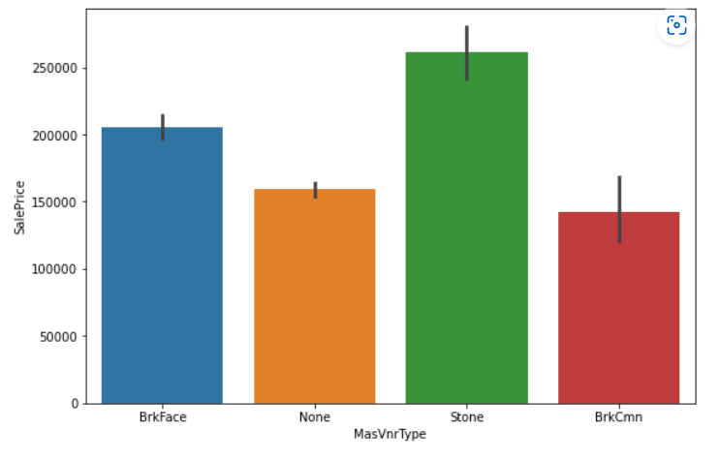
MASVNRTYPE -> Majority are Stone

Slide 22
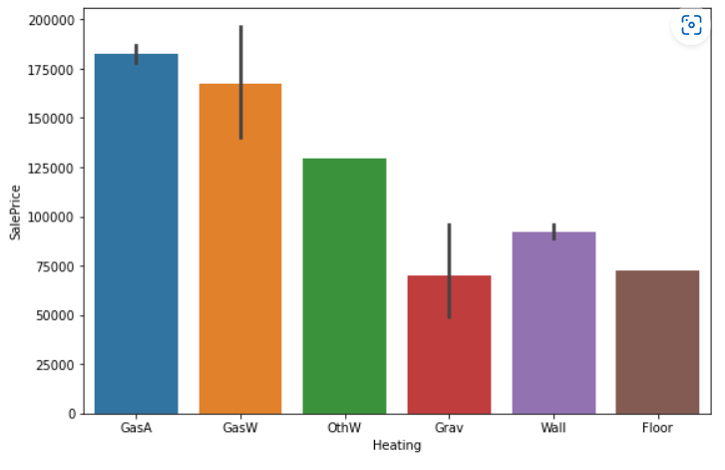
HEATING -> Majority are GasA GasW

Slide 23
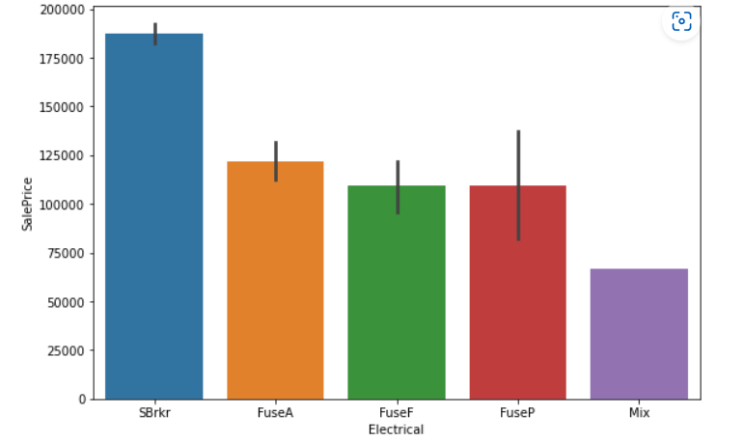
ELECTRICAL -> Majority are SBrkr

Slide 24
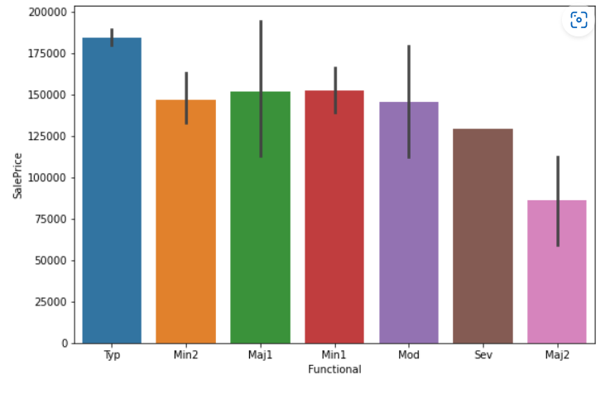
FUNCTIONAL -> Majority are Typ

Slide 25
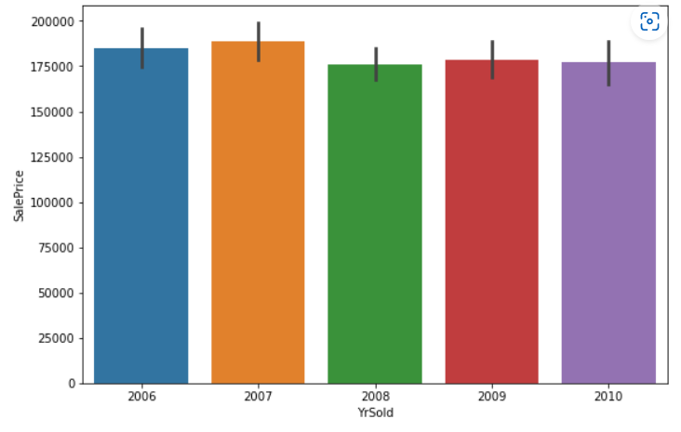
YRSOLD -> Majority are ALL year

Slide 26
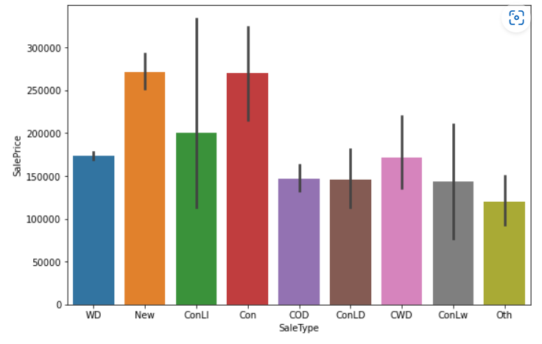
SALETYPE -> Majority are ConLI

Slide 27
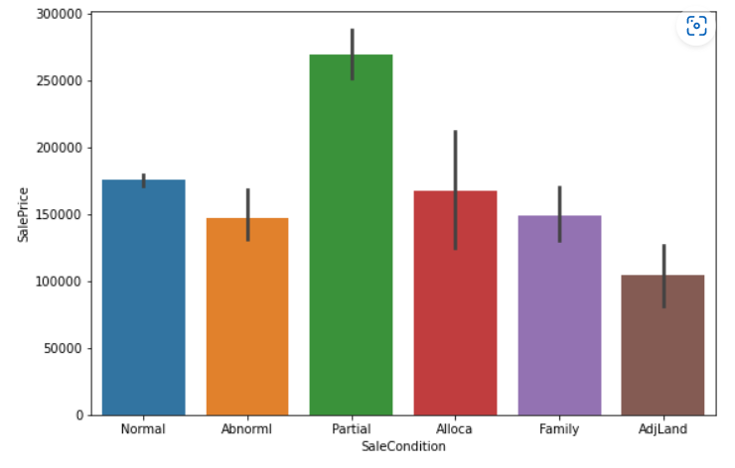
SALECONDITION -> Majority are Partial

Slide 28
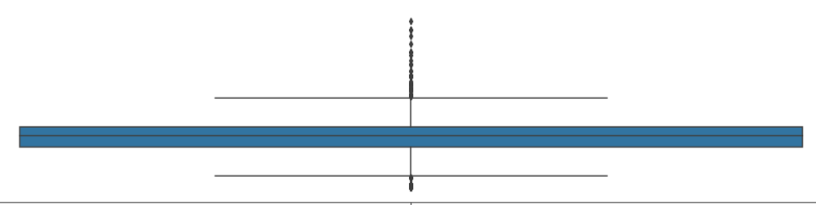
Removing Outliers for ALL Continuous columns

Slide 29
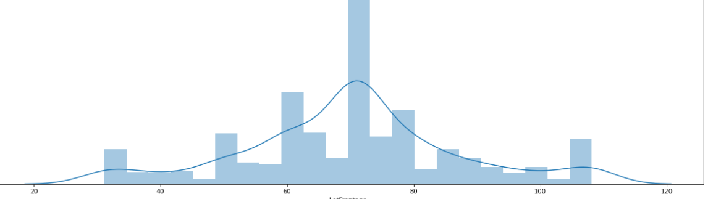
Removing SKEWNESS FOR ALL Continuous columns

Slide 30
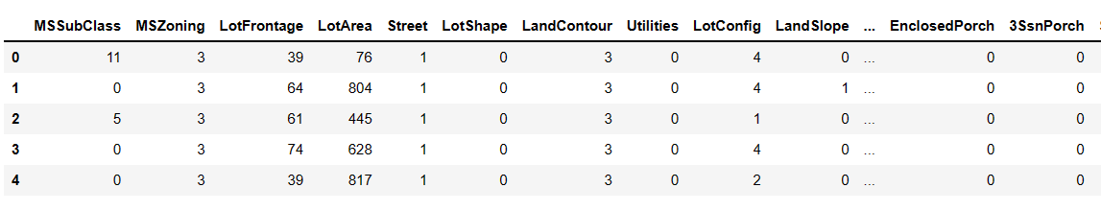
Encoding:

Slide 31
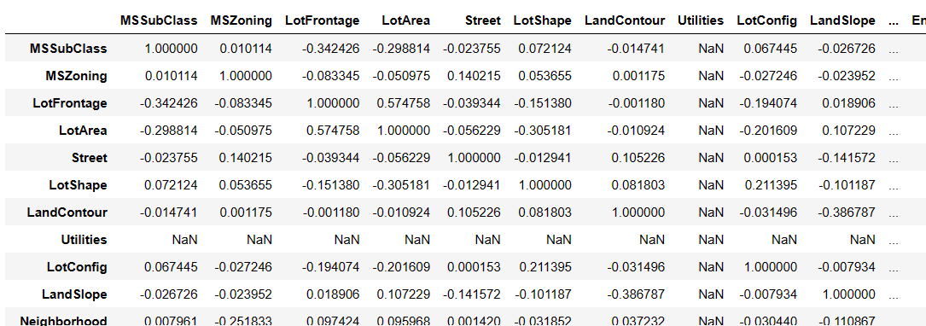
Correlation using HEAT map:

Slide 32
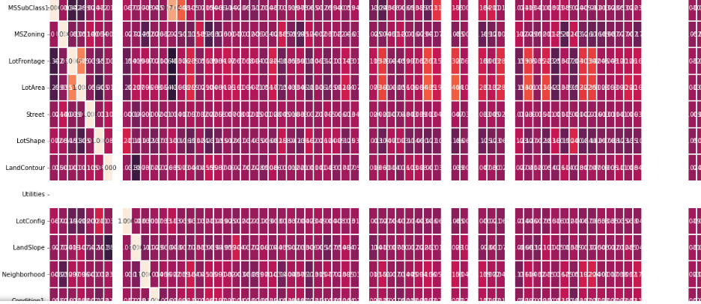
Heat map.

Slide 33
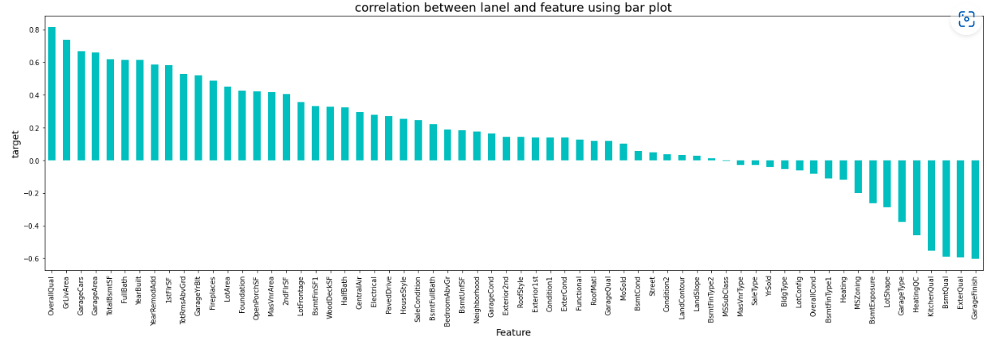
Visualizing the correlation between label and features using bar plot

Slide 34

Dividing data in feature and Label

Slide 35
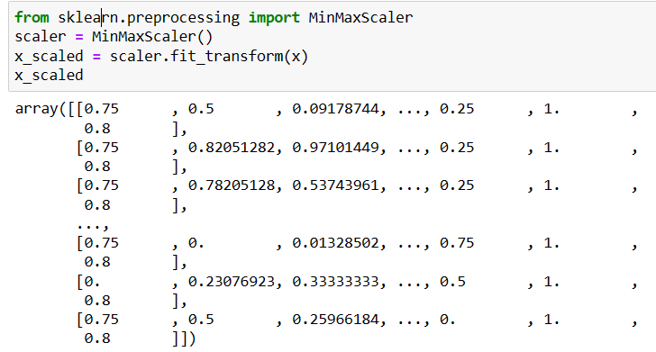
MinMaxScaler

Slide 36
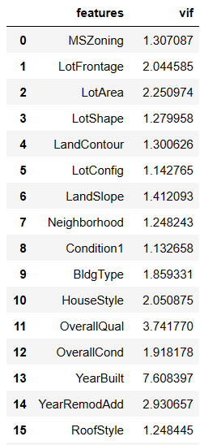
Now use VIF for checking multicollinearity problem

Slide 37
Model Building
1) Logistic Regression
2) XGBOOST
3) Ada Boost Regressor
4) Gradient Boosting Regressor
5) Random Forest

Slide 38
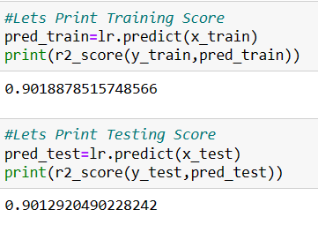
Logistic Regression

Slide 39
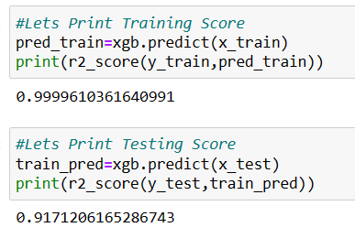
XGBOOST

Slide 40
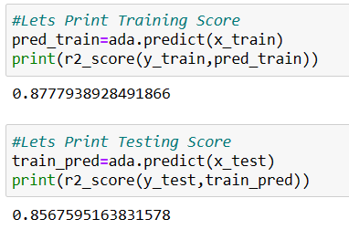
Ada Boost Regressor

Slide 41
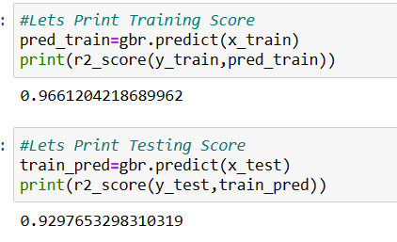
Gradient Boosting Regressor

Slide 42
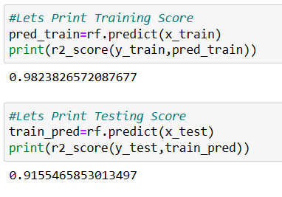
Random Forest

Slide 43
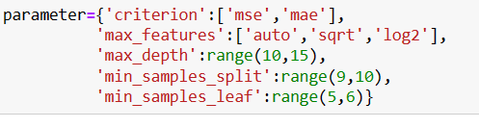
Hyperparameter tuning.

Slide 44
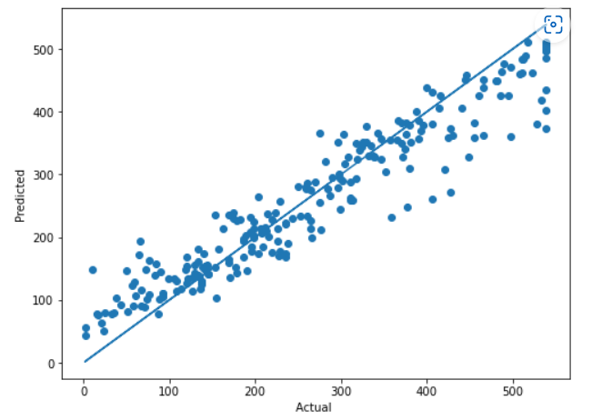
Plot Actual VS Predicted

Slide 45
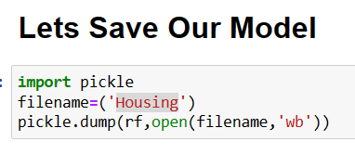
Lets Save Our Model

Slide 46
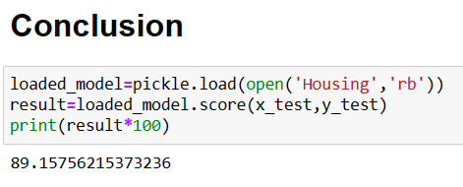
Conclusion

Slide 47

THANK YOU

